Slide 1
Introduction to Machine Learning
Wen-Cheng Lin
Department of Medical Informatics
Tzu Chi University

Slide 2
Outline
What is machine learning
Types of learning problems
Input data
Knowledge representation
Learning methods

Slide 3
Machine Learning
The question
  “How can we build computer systems that automatically improve with experience, and what are the fundamental laws that govern all learning processes?”

Slide 4
Machine Learning
Study of algorithms that make computer programs to
  Improve their performance with respect to performance measure P
  At some task T
  Based on experience E (or example data)

Slide 5
Machine Learning
Handwriting recognition learning problem
  T: recognizing and classifying handwritten words within images
  P: percent of words correctly classified
  E: a database of handwritten words with given classifications

Slide 6
Why Machine Learning
Growing flood of data
  Data is cheap and abundant, knowledge is expensive and scarce
    Widespread use of personal computers and wireless communication leads to “big data”
    We are both producers and consumers of data

Slide 7
Why Machine Learning
    Data is not random, it has structure, e.g., customer behavior
    Effectively exploitation of information is beyond the capability of human
    We need “big theory” to extract that structure from data for
    (a) Understanding the process
    (b) Making predictions for the future

Slide 8
Why Machine Learning
Programs too difficult to program by hand
  Human expertise does not exist
    Navigating on Mars
  Humans are unable to explain their expertise
    Speech recognition
    Human face recognition

Slide 9
Why Machine Learning
Programs must dynamically adapt to changing conditions
  Solution changes in time
    Routing on a computer network
  Solution needs to be adapted to particular cases
    Newsreader that learns user interests

Slide 10
Machine Learning
Learning general models from a data of particular examples
  Build a model that is a good and useful approximation to the data
  Search a very large space of possible hypotheses to find the hypothesis that best fits the available training examples and other prior knowledge held by the learner

Slide 11
Learning and Generalization
A good hypothesis will generalize well
  Will predict unseen examples correctly
  It might be better to use a simple hypothesis that is not exactly consistent but might make reasonable predictions

Slide 12
Machine Learning
Role of Statistics
  Inference from a sample
Role of Computer science
  Efficient algorithms to
    Solve the optimization problem
    Representing and evaluating the model for inference

Slide 13
Machine Learning
Machine learning is preferred approach to
  Speech recognition, Natural language processing
  Computer vision
  Medical outcomes analysis
  Robot control
  …

Slide 14
Machine Learning
This trend is accelerating
  Improved machine learning algorithms
  Improved data capture, networking, faster computers
  Software too complex to write by hand
  New sensors / IO devices
  Demand for self-customization to user, environment

Slide 15
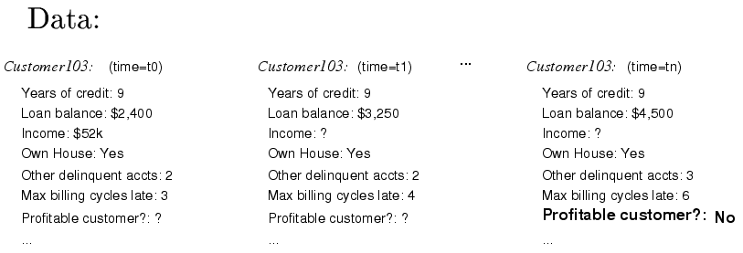
Typical Data Mining Task
Credit risk analysis
  Given: questionnaire with financial and personal information
  Problem: should credit card application be accepted?

Slide 16
Data Mining Result
Two of the learned rules
  If Other-Delinquent-Accounts > 2, and
  Number-Delinquent-Billing-Cycles > 1
  Then Profitable-Customer? = No
  [Deny Credit Card application]
  If Other-Delinquent-Accounts =0, and
  (Income > $30k) OR (Years-of-Credit > 3)
  Then Profitable-Customer? = Yes
  [Accept Credit Card application]

Slide 17
Types of learning problems

Slide 18
Types of Learning
The type of feedback available for learning
  Supervised learning
    Given input instances and their correct output values
      An example is a pair (x,f(x))
    Learn a (approximate) function h from examples of its input and output
      h is called hypothesis
      Hypothesis space H
        The set of all possible hypotheses
    Classification
    Regression

Slide 19
Types of Learning
  Unsupervised learning
    Given input instances without output values
    Learn patterns, inherent organization in the input
    Clustering
    Learning Associations
  Reinforcement learning
    No teacher tells what to do, must learn from reinforcement, or reward
    Learn how to choose a sequence of actions (policy) over time so as to obtain large rewards
    Game playing
    Robot in a maze

Slide 20
Types of Learning
Training regimes
  Batch
    The training data can be given all in advance
    Use all training data at once to compute the function
  Online
    The training data is given incrementally, one at a time
    Estimate and update the model after each example arrives

Slide 21
Classification
Aka Pattern recognition
Each instance belongs to one of the predefined classes
Learn a function to predict which class a new instance should belong to, based on a given set of training samples

Slide 22
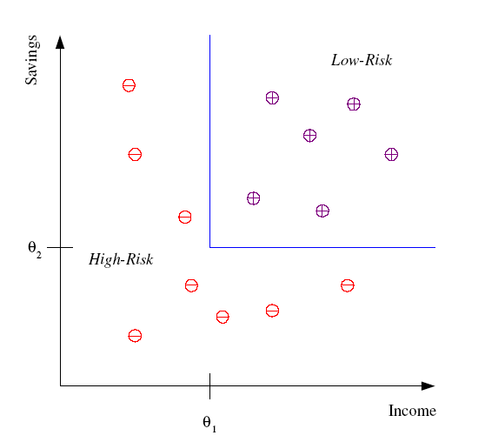
Classification
Credit scoring
Differentiating between low-risk and high-risk customers from their income and savings
Discriminant: IF income > θ₁ AND savings > θ₂
THEN low-risk ELSE high-risk

Slide 23
Classification
Face detection
Given as input an arbitrary image, determine whether there are any human faces in the image, and if there are, return an encoding of their location

Slide 24
Classification
Face recognition
  Pose, lighting, occlusion (glasses, beard), make-up, hair style
Character recognition
  Different handwriting styles
Speech recognition
  Temporal dependency
  Use of a dictionary or the syntax of the language
Medical diagnosis
  From symptoms to illnesses
...

Slide 25
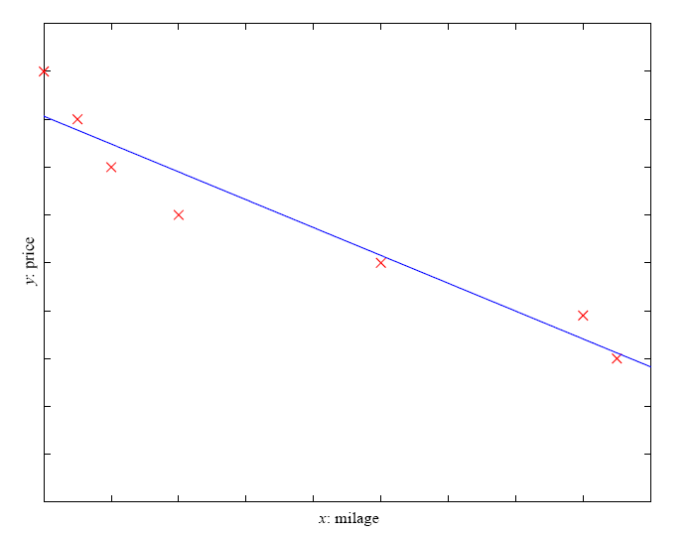
Regression
Given a set of training examples
{(x₁,y₁),…, (x_{n},y_{n})}
Learn a mapping
h : X → Y such that
y_{i} ≈ h(x_{i}), i = 1,…, n
    Example: Price of a used car
    x : car attributes
    y : price
    y = g (x | θ )
    g( ): model,
    θ : parameters
y = wx+w₀

Slide 26
Clustering
Group a set of instances based on their similarities
Example applications
  Customer segmentation in CRM
  Text clustering
  Image compression: Color quantization
  Bioinformatics: Learning motifs

Slide 27
Learning Associations
Detecting associations between features
Example: Basket analysis
  P (Y | X ) probability that somebody who buys X also buys Y where X and Y are products/services
  P ( chips | beer ) = 0.7

Slide 28
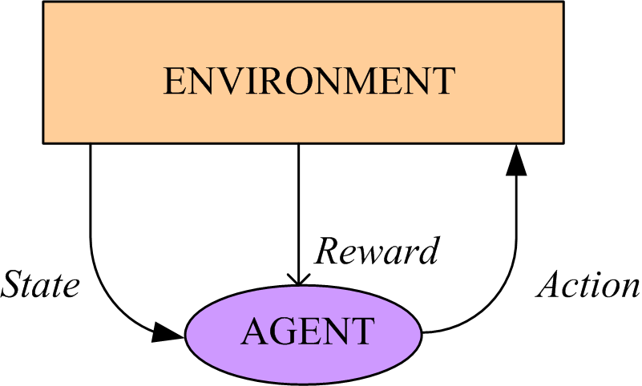
Game Playing
Learn to play backgammon (TD-Gammon)
  Immediate reward
    +100 if win
    -100 if lose
    0 for all other states
  Trained by playing million games against itself
  Now approximately equal to best human player

Slide 29
Input Data

Slide 30
Input Data
Instance
  Thing to be classified, associated, or clustered
  Individual, independent example of target concept
  Characterized by a predetermined set of attributes
Possible attribute types
  Nominal, ordinal, interval and ratio

Slide 31
Input Data
Example days
Example | Sky | AirTemp | Humidity | Wind | Water | Forecast | EnjoySport
1 | Sunny | Warm | Normal | Strong | Warm | Same | Yes
2 | Sunny | Warm | High | Strong | Warm | Same | Yes
3 | Rainy | Cold | High | Strong | Warm | Change | No
4 | Sunny | Warm | High | Strong | Cool | Change | Yes
Example | Sky | AirTemp | Humidity | Wind | Water | Forecast | EnjoySport
1 | Sunny | 85 | 85 | Strong | Warm | Same | Yes
2 | Sunny | 80 | 90 | Strong | Warm | Same | Yes
3 | Rainy | 70 | 96 | Strong | Warm | Change | No
4 | Sunny | 75 | 70 | Strong | Cool | Change | Yes

Slide 32
Knowledge Representation

Slide 33
Knowledge Representation
Many different ways of representing patterns
  Decision trees, rules, instance-based, …
Understanding the output is the key to understanding the underlying learning methods
Different types of output for different learning problems (e.g. classification, regression, …)

Slide 34
Knowledge Representation
Decision tables
Decision trees
  Internal node
    Test attribute
  Branch
    Attribute value
  Leaf
    Classification
Sky | AirTemp | EnjoySport
Sunny | Warm | Yes
Rainy | Cold | No

Slide 35
Knowledge Representation
Classification rules
  If Sky = Sunny and AirTemp = Warm
  then EnjoySport =Yes
  If Sky = Rainy and AirTemp = Cold
  then EnjoySport =No
Association rules
  If Sky = Sunny then AirTemp = Warm
  If Sky = Sunny and AirTemp = Warm
  then Wind = Strong and EnjoySport =Yes

Slide 36
Knowledge Representation
Conjunction of constraints on the instance attributes
  <Sunny, Warm, ?, ?, ?, ?>
Polynomial function
  3x²+2
Probability

Slide 37
Knowledge Representation
Instance-based representation
  Simply store the training instances
  The instances themselves represent the knowledge
Clusters
  Show how instances fall into clusters

Slide 38
ML Example:
Regression

Slide 39
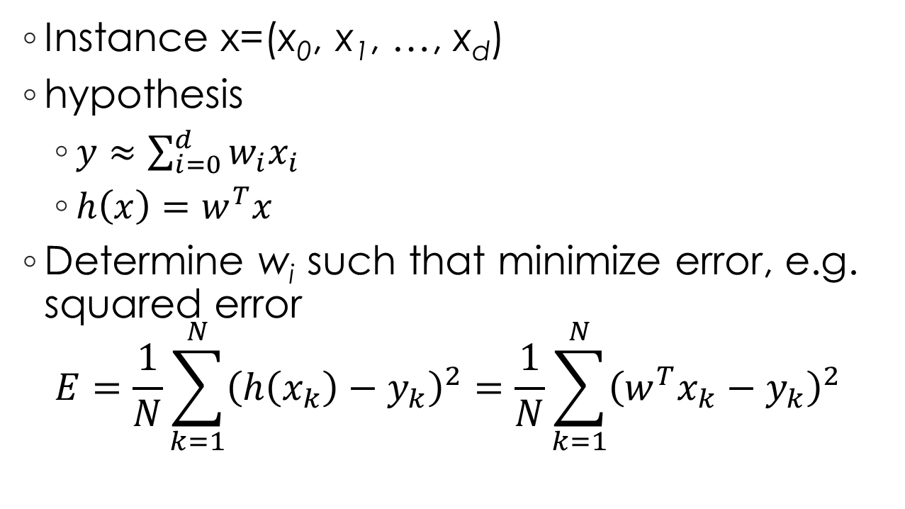
Linear Regression
Instance x=(x₀, x₁, …, x_{d})
hypothesis
  $y≈\sum_{i=0}^{d}{w_{i}x_{i}}$
  $h\left(x\right)=w^{T}x$
Determine w_{i} such that minimize error, e.g. squared error
$E=\frac{1}{N}\sum_{k=1}^{N}{{\left(h\left(x_{k}\right)−y_{k}\right)}^{2}}=\frac{1}{N}\sum_{k=1}^{N}{{\left(w^{T}x_{k}−y_{k}\right)}^{2}}$

Slide 40
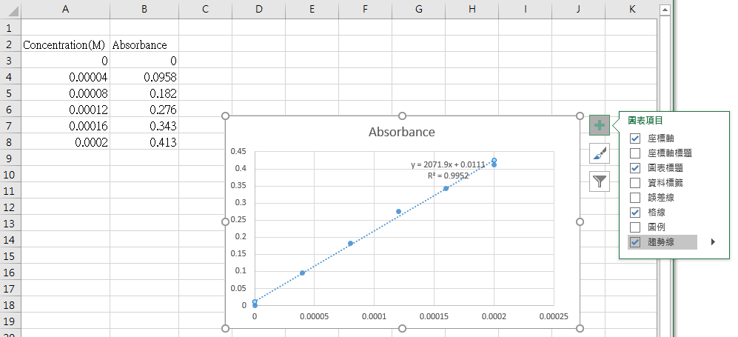

Slide 41
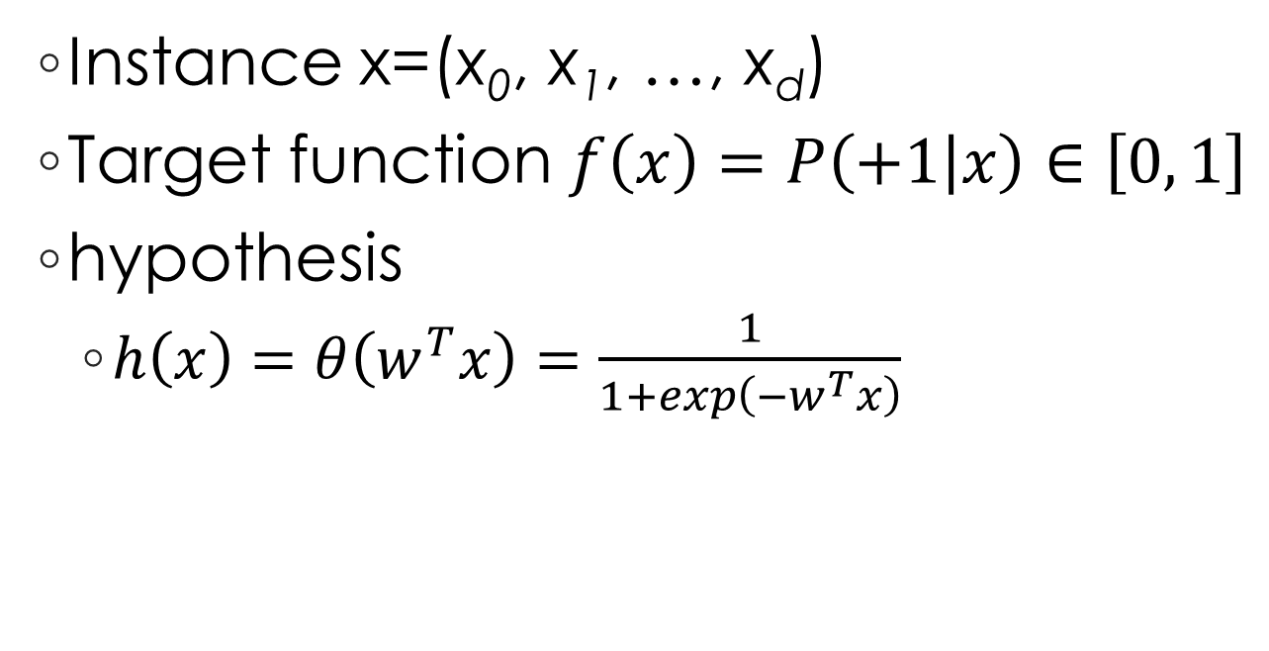
Logistic Regression
Instance x=(x₀, x₁, …, x_{d})
Target function $f\left(x\right)=P\left(+1 | x\right)∈\left[0, 1\right]$
hypothesis
  $h\left(x\right)=θ\left(w^{T}x\right)=\frac{1}{1+exp\left(−w^{T}x\right)}$

